Slide 1
Block-Spring Model of Earthquakes and Self-Organized Criticality
Adrian Martin

Slide 2

Background
Tectonic plates
What are earthquakes?
How can we predict earthquakes?

Slide 3
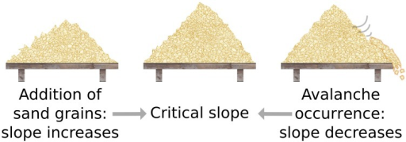
Self Organized Criticality
Critical point: A set of properties that make an event likely to occur
Self Organized Criticality: The shift towards a critical point as a result of the phenomena
Sandpile analogy
For earthquakes:
Critical point: Temperature and density in the earth’s crust that make earthquakes likely to occur

Slide 4
Gutenberg-Richter Law
The probability of an earthquake of a certain magnitude decays exponentially with magnitude
P(M)=Ae^{−bM}
From real-life statistics: b = 1 +/- 0.1

Slide 5
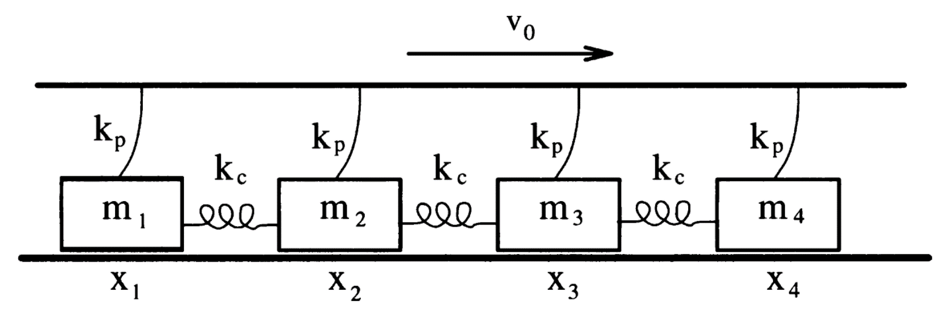
Block Spring Model
Proposed by Burridge and Knopoff in 1967.
Uses blocks to represent fault line from top view.

Slide 6
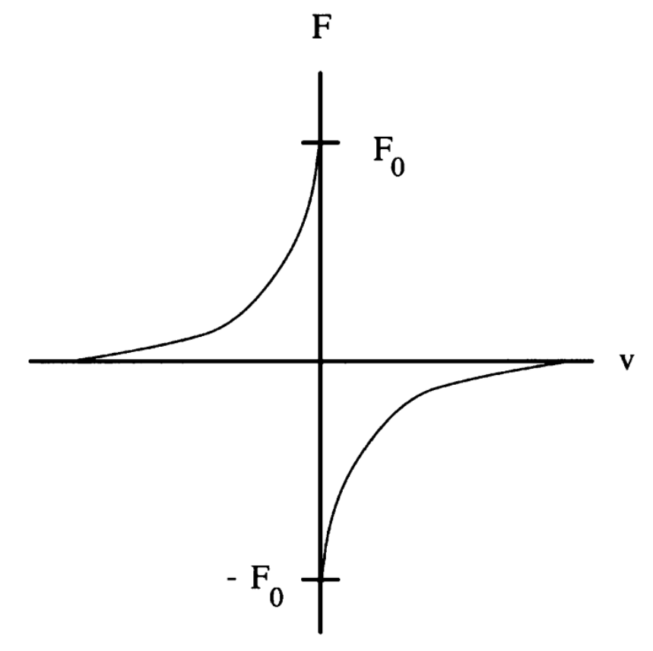
Friction Model
Stick-slip model
Friction decreases with velocity
There are other possible models

Slide 7
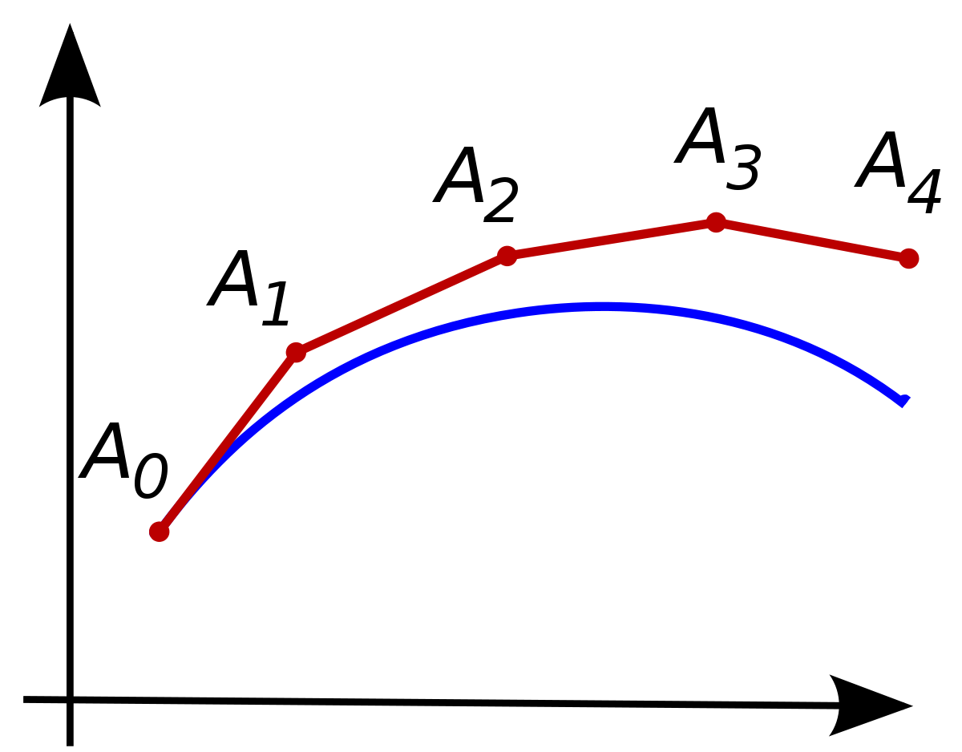
Python Model
Euler method
Numerical solutions to differential equations
Calculates A(t + Δt) based on A(t)
Δt is the timestep
Shorter timestep = more accurate model
My model
Coupled
Adaptive step size
Calculates array of block positions and velocities at each timestep

Slide 8
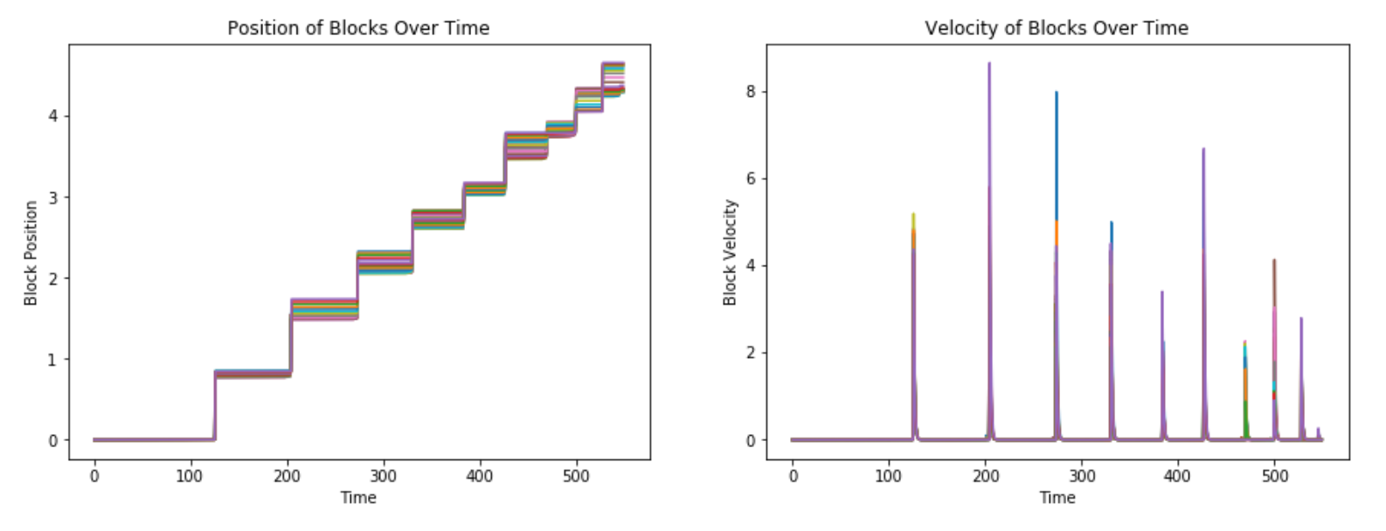
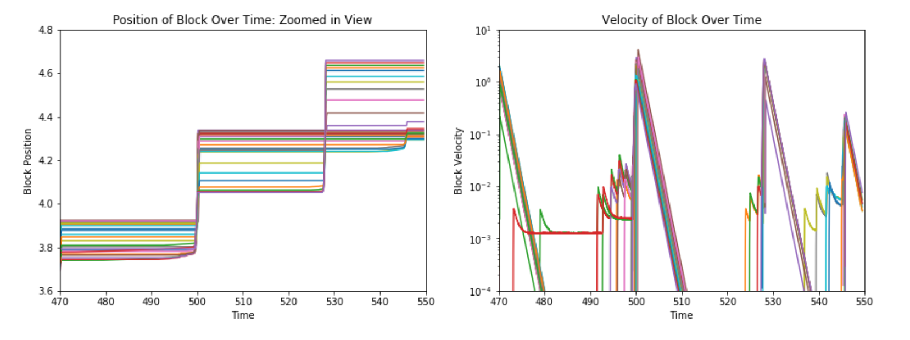
Results Over Short Time Period

Slide 9
Counting Earthquakes
Magnitude = log ( Σ_{n = time} (Σ_{i = blocks} v_{i} Δt ))
Earthquake starts when a block accelerates
Ends when v_{i} = 0 for all blocks
Maximum earthquake length set equal to 1

Slide 10
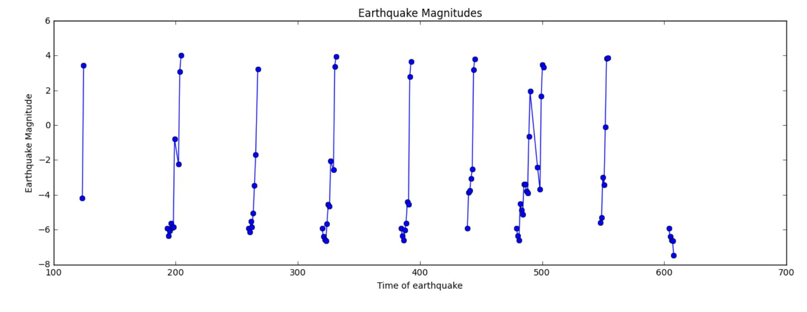
Earthquake Pattern

Slide 11
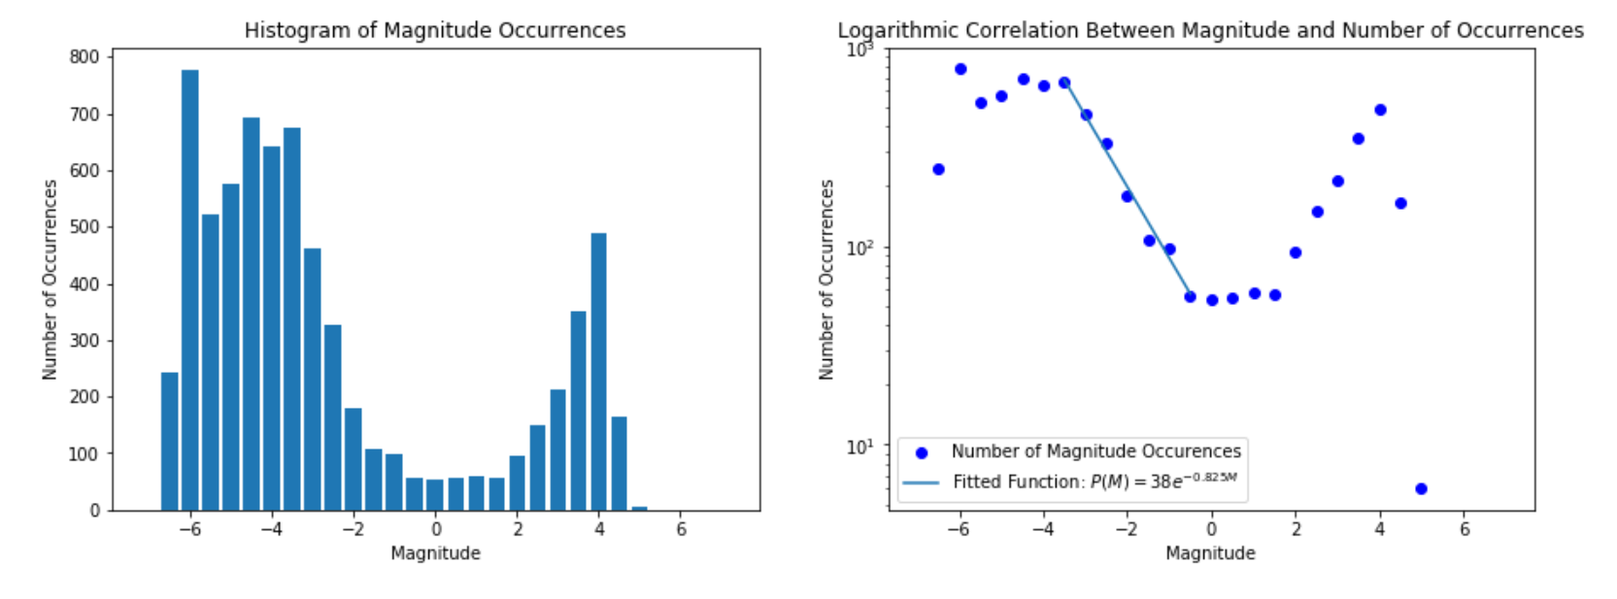
Results Over Large Time Period
5,000,000 timesteps, 100 blocks, 7048 total earthquakes
Decaying exponential within magnitude range -3 to 0
Excess of large earthquakes
b = 0.825

Slide 12
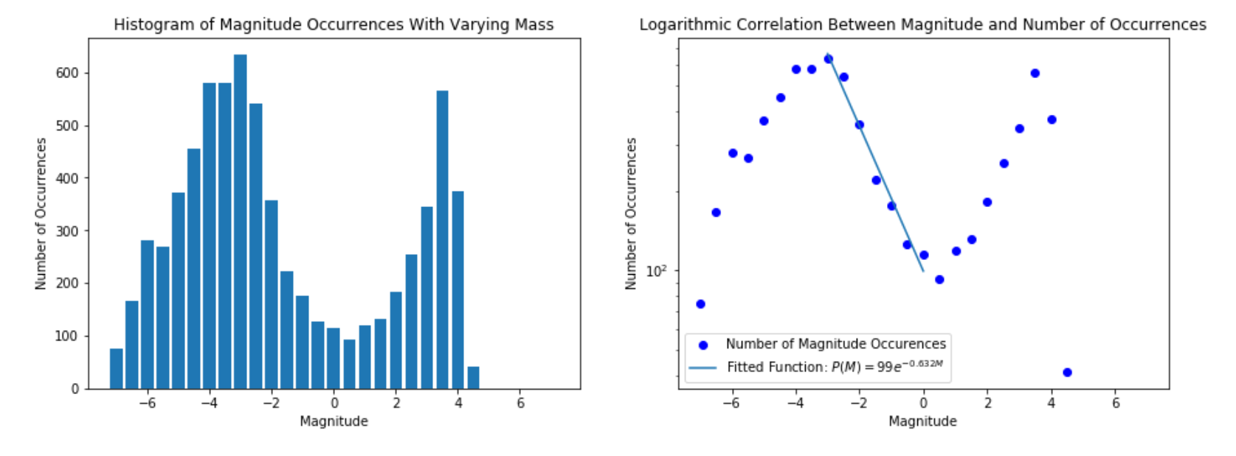
Results With Varied Masses
5,000,000 timesteps, 100 blocks, 7056 total earthquakes
Varied masses from 0.5 to 2 mass units
Excess of large earthquakes
b = 0.632

Slide 13
Conclusion
Model produced accurate statistics for small magnitudes, but not large ones
Varying masses did not make a large difference
Possible improvements:
Vary Kc
Use more blocks
Refine friction model
Reduce numerical error
The earthquake patterns over a small time period are consistent with real earthquakes
May help us predict when earthquakes are likely to occur

Slide 14
References
[1] Giordano N. 1997. Computational Physics. Upper Sadie River, NJ: Pretence-Hall inc. p. 315-328
[2] Sammis C, Smith S. 1999. Seismic Cycles and the Evolution of Stress Correlation in Cellular Automaton Models of Finite Fault Networks. Pure and Applied Geophysics. 155(1)
[3] R. Burridge, L. Knopoff; Body force equivalents for seismic dislocations. Bulletin of the Seismological Society of America ; 54 (6A): 1875–1888
[4] Márquez-Ramírez, V.H., Nava, F.A. & Zúñiga, F.R. Correcting the Gutenberg–Richter b-value for effects of rounding and noise. Earthq Sci (2015) 28: 129.
[5] Spence, William, et al. “Measuring the Size of an Earthquake.” U.S. Geological Survey, 1989.
[6] Brochini, L. et al. "Phase transitions and self-organized criticality in networks of stochastic spiking neurons." Sci. Rep. 6, 35831; doi: 10.1038/srep35831 (2016).
[7] "Plate Tectonics." Bucknell University, 2017.
[8] “Seismicity and Earthquake Hazard in the UK.” Seismicity And Earthquake Hazard In The UK, National Environment Research Council, 2018.
Image sources:
https://www.hope-education.co.uk/product/primary/geography/physical-geography/tectonic-plates-map/he1534836
https://en.wikipedia.org/wiki/Euler_method
https://openi.nlm.nih.gov/detailedresult.php?img=PMC4171833_fnsys-08-00166-g0002&req=4

